Slide 1
Mark 3:20-35 (NIV)
²⁰Then Jesus entered a house, and again a crowd gathered, so that he and his disciples were not even able to eat. ²¹When his family heard about this, they went to take charge of him, for they said, “He is out of his mind.”
Marc 3:20-35 (Beibl.net)
²⁰Pan aeth Iesu yn ôl i'r tŷ lle roedd yn aros, roedd cymaint o dyrfa wedi casglu yno nes bod dim cyfle i'w ddisgyblion ac yntau gael bwyta hyd yn oed. ²¹Pan glywodd ei deulu am hyn, dyma nhw'n penderfynu fod rhaid rhoi stop ar y peth. “Mae'n wallgof”, medden nhw.

Slide 2
²²And the teachers of the law who came down from Jerusalem said, “He is possessed by Beelzebul! By the prince of demons he is driving out demons.”
²³So Jesus called them over to him and began to speak to them in parables: “How can Satan drive out Satan?
²²Roedd yr arbenigwyr yn y Gyfraith, oedd wedi teithio o Jerwsalem, yn dweud amdano, “Mae wedi'i feddiannu gan Beelsebwl, tywysog y cythreuliaid! Dyna sut mae'n gallu bwrw allan gythreuliaid!”
²³Felly dyma Iesu'n eu galw draw ac yn eu hateb drwy ddefnyddio darlun: “Sut mae Satan yn gallu bwrw ei hun allan?

Slide 3
²⁴If a kingdom is divided against itself, that kingdom cannot stand. ²⁵If a house is divided against itself, that house cannot stand. ²⁶And if Satan opposes himself and is divided, he cannot stand; his end has come. ²⁷In fact, no one can enter a strong man’s house without first tying him up.
²⁴Dydy teyrnas lle mae rhyfel cartref byth yn mynd i sefyll! ²⁵Neu os ydy teulu'n ymladd â'i gilydd o hyd, bydd y teulu hwnnw'n chwalu. ²⁶A'r un fath, os ydy Satan yn ymladd yn erbyn ei hun a'i deyrnas wedi'i rhannu, fydd e ddim yn sefyll; mae hi ar ben arno! ²⁷Y gwir ydy, all neb fynd i mewn i gartre'r dyn cryf a dwyn ei eiddo heb rwymo'r dyn cryf yn gyntaf.

Slide 4
Then he can plunder the strong man’s house. ²⁸Truly I tell you, people can be forgiven all their sins and every slander they utter, ²⁹but whoever blasphemes against the Holy Spirit will never be forgiven; they are guilty of an eternal sin.”
³⁰He said this because they were saying, “He has an impure spirit.”
Bydd yn gallu dwyn popeth o'i dŷ wedyn. ²⁸Credwch chi fi – mae maddeuant i'w gael am bob pechod, hyd yn oed am gabledd, ²⁹ond does dim maddeuant i'r sawl sy'n cablu yn erbyn yr Ysbryd Glân; mae'r person hwnnw'n euog o bechod sy'n aros am byth.”
³⁰(Dwedodd hyn am eu bod wedi dweud fod ysbryd drwg ynddo.)

Slide 5
³¹Then Jesus’ mother and brothers arrived. Standing outside, they sent someone in to call him. ³²A crowd was sitting around him, and they told him, “Your mother and brothers are outside looking for you.”
³³“Who are my mother and my brothers?” he asked.
³¹Dyna pryd y cyrhaeddodd mam Iesu a'i frodyr yno. Dyma nhw'n sefyll y tu allan, ac yn anfon rhywun i'w alw. ³² Roedd tyrfa yn eistedd o'i gwmpas, a dyma nhw'n dweud wrtho, “Mae dy fam a dy frodyr y tu allan yn edrych amdanat ti.”
³³Atebodd, “Pwy ydy fy mam a'm brodyr i?”

Slide 6
³⁴Then he looked at those seated in a circle around him and said, “Here are my mother and my brothers! ³⁵Whoever does God’s will is my brother and sister and mother.”
³⁴“Dyma fy mam a'm brodyr i!” meddai, gan edrych ar y rhai oedd yn eistedd mewn cylch o'i gwmpas. ³⁵“Mae pwy bynnag sy'n gwneud beth mae Duw eisiau yn frawd a chwaer a mam i mi.”

Slide 7
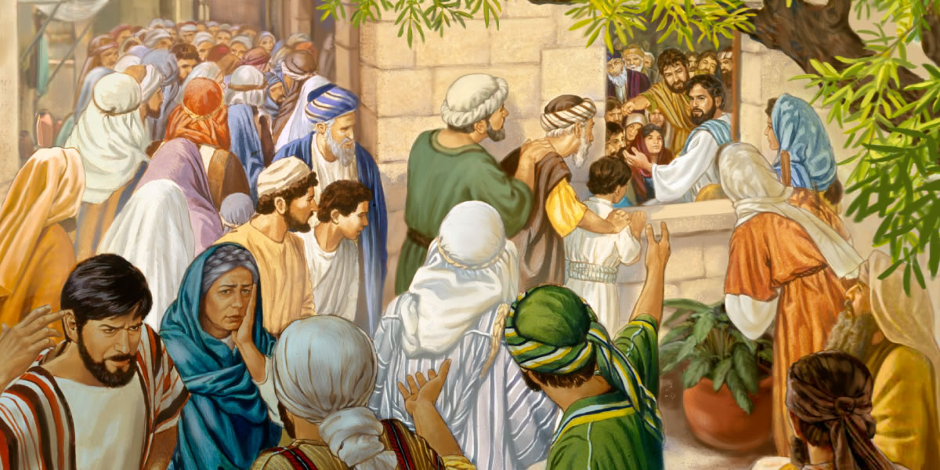
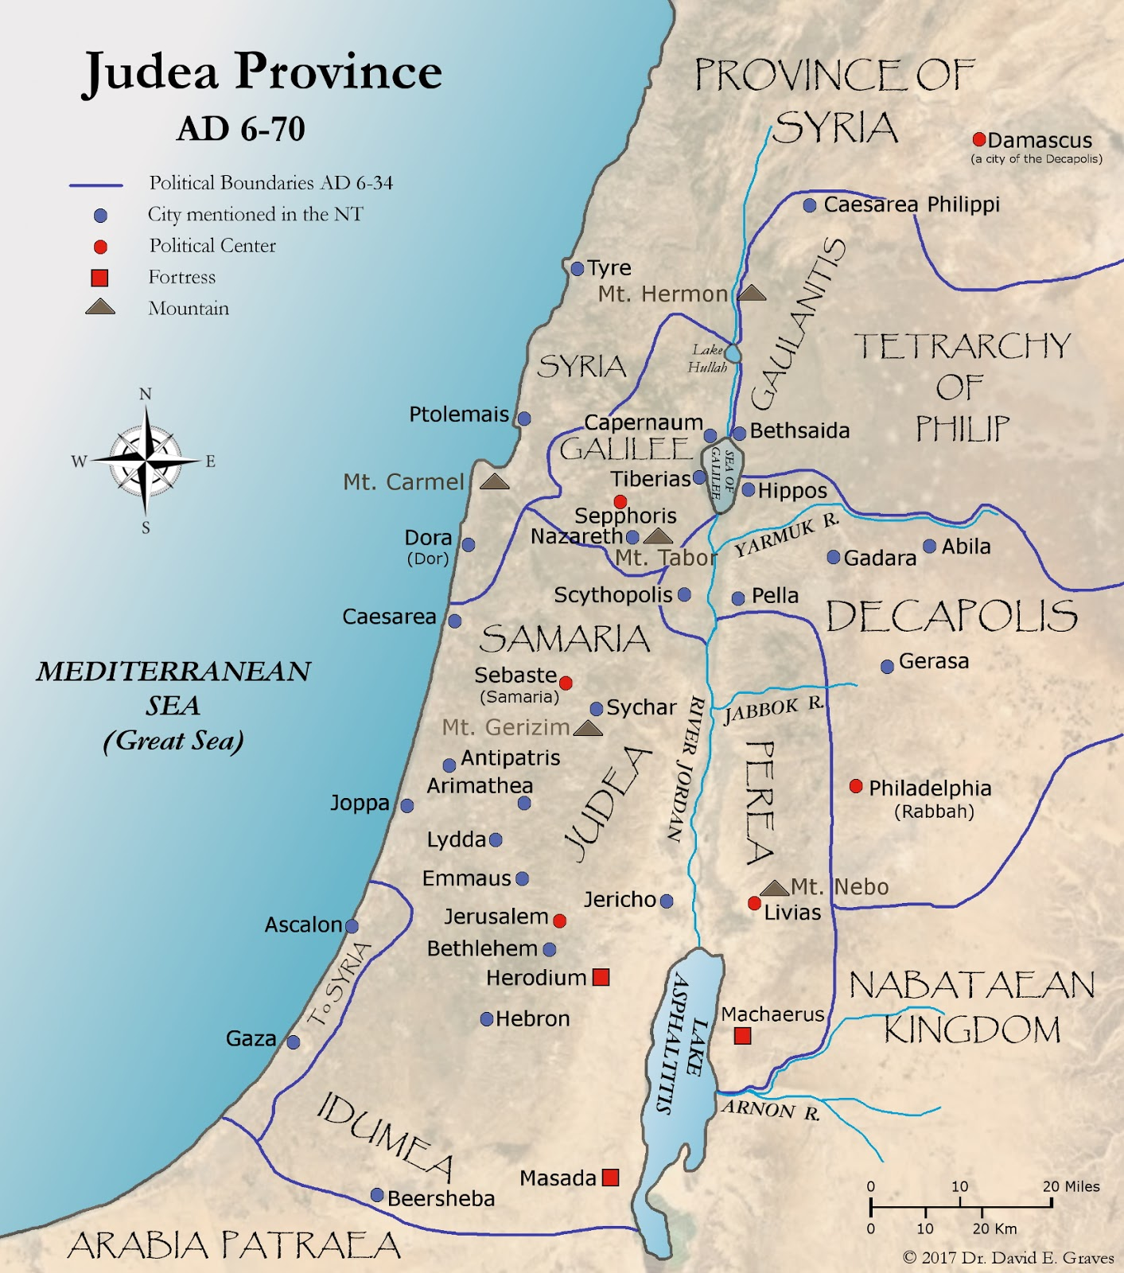
(v. 21) “He is out of his mind”
© 2017 Dr. David E. Graves

Slide 8
“…if the definition of a fanatic is somebody zealous for their faith, then I would be proud to be called a fanatic. If I am a religious fanatic in that sense, please pray for me that I get worse.”
- R. C. Sproul

Slide 9
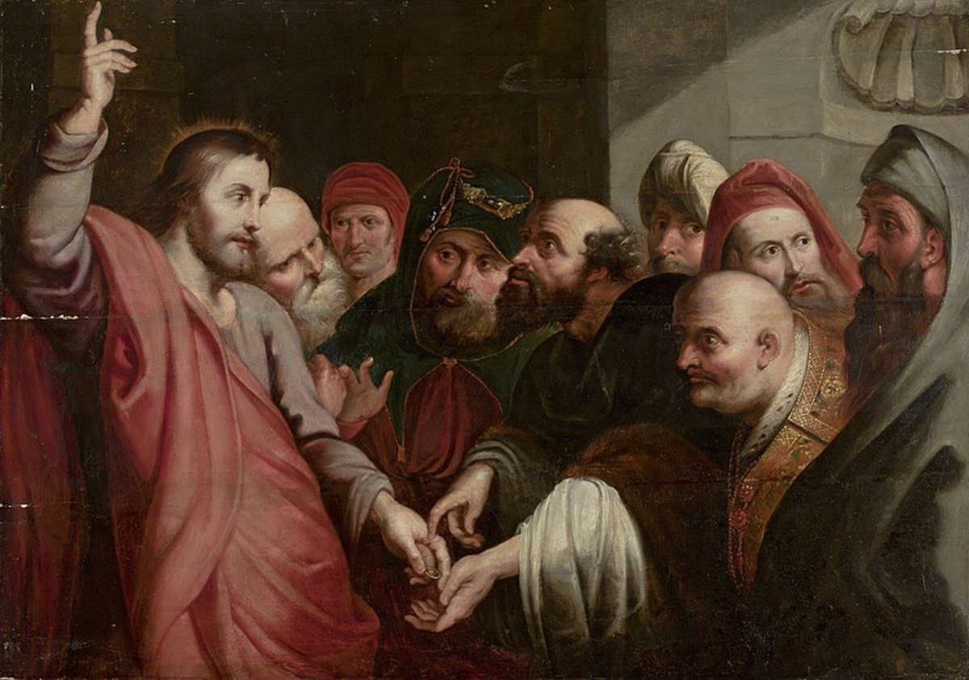
(v. 22) “He is possessed by Beelzebul! By the prince of demons he is driving out demons.”
(v. 23) “How can Satan drive out Satan?”

Slide 10
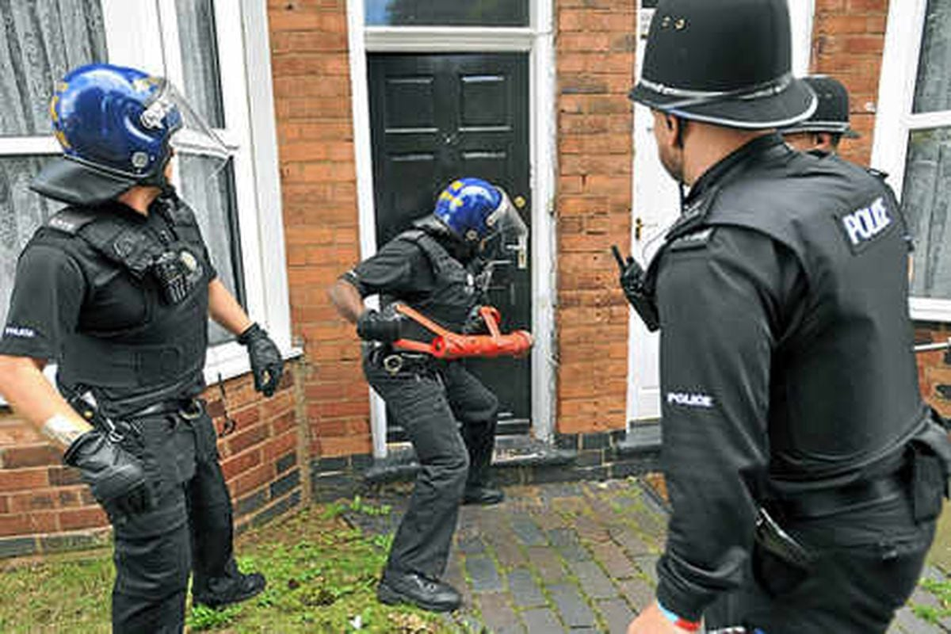
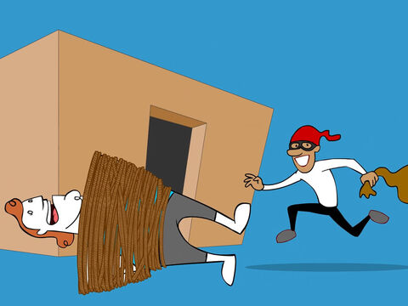
(v. 27) “In fact, no one can enter a strong man’s house without first tying him up. Then he can plunder the strong man’s house.”

Slide 12
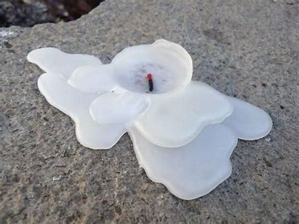
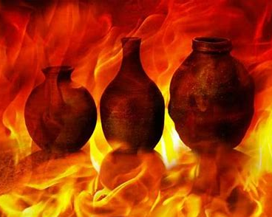

Slide 13
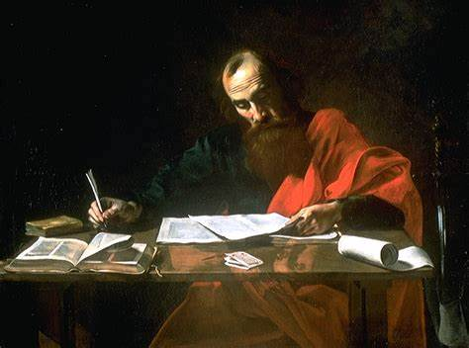
(Tim. 12-13) ‘I thank Christ Jesus our Lord, who has given me strength, that he considered me trustworthy, appointing me to his service. Even though I was once a blasphemer and a persecutor and a violent man, I was shown mercy because I acted in ignorance and unbelief’

Slide 14
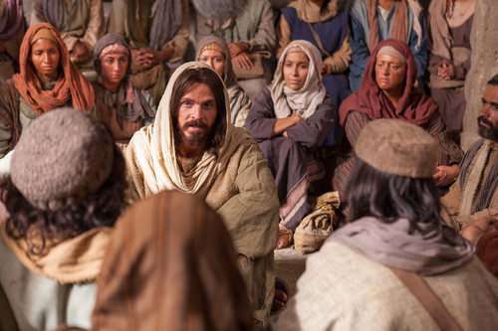
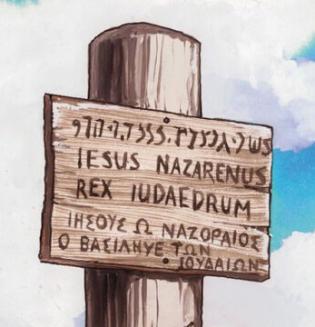
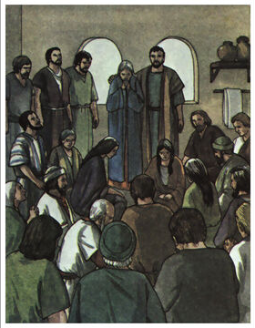
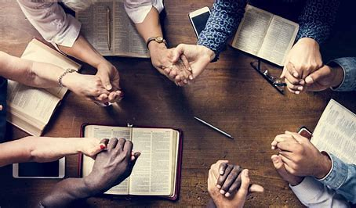
(v. 33) “Who are my mother and my brothers?”

